Slide 1
MSDS 696 DATA SCIENCE PRACTICUM II | WEEK 3
Predicting U.S. Bank Undercapitalization
Early Signs Before Undercapitalization
Oussama Ennaciri | July 2026
Notes:
I'm Oussama. I'm building a model to predict U.S. bank undercapitalization. This week, I went through the data looking for early signs of undercapitalization.

Slide 2
UNDERCAPITALIZATION
LEGAL MINIMUM 8%
Notes:
Quick context so my target is clear to everyone.
Every bank keeps a reserve of money, so there's always enough for people to withdraw.
By law, that reserve has to stay above 8 percent, or the bank falls to undercapitalized status, which puts it at risk of failing.
That risk is what I'm trying to predict.

Slide 3
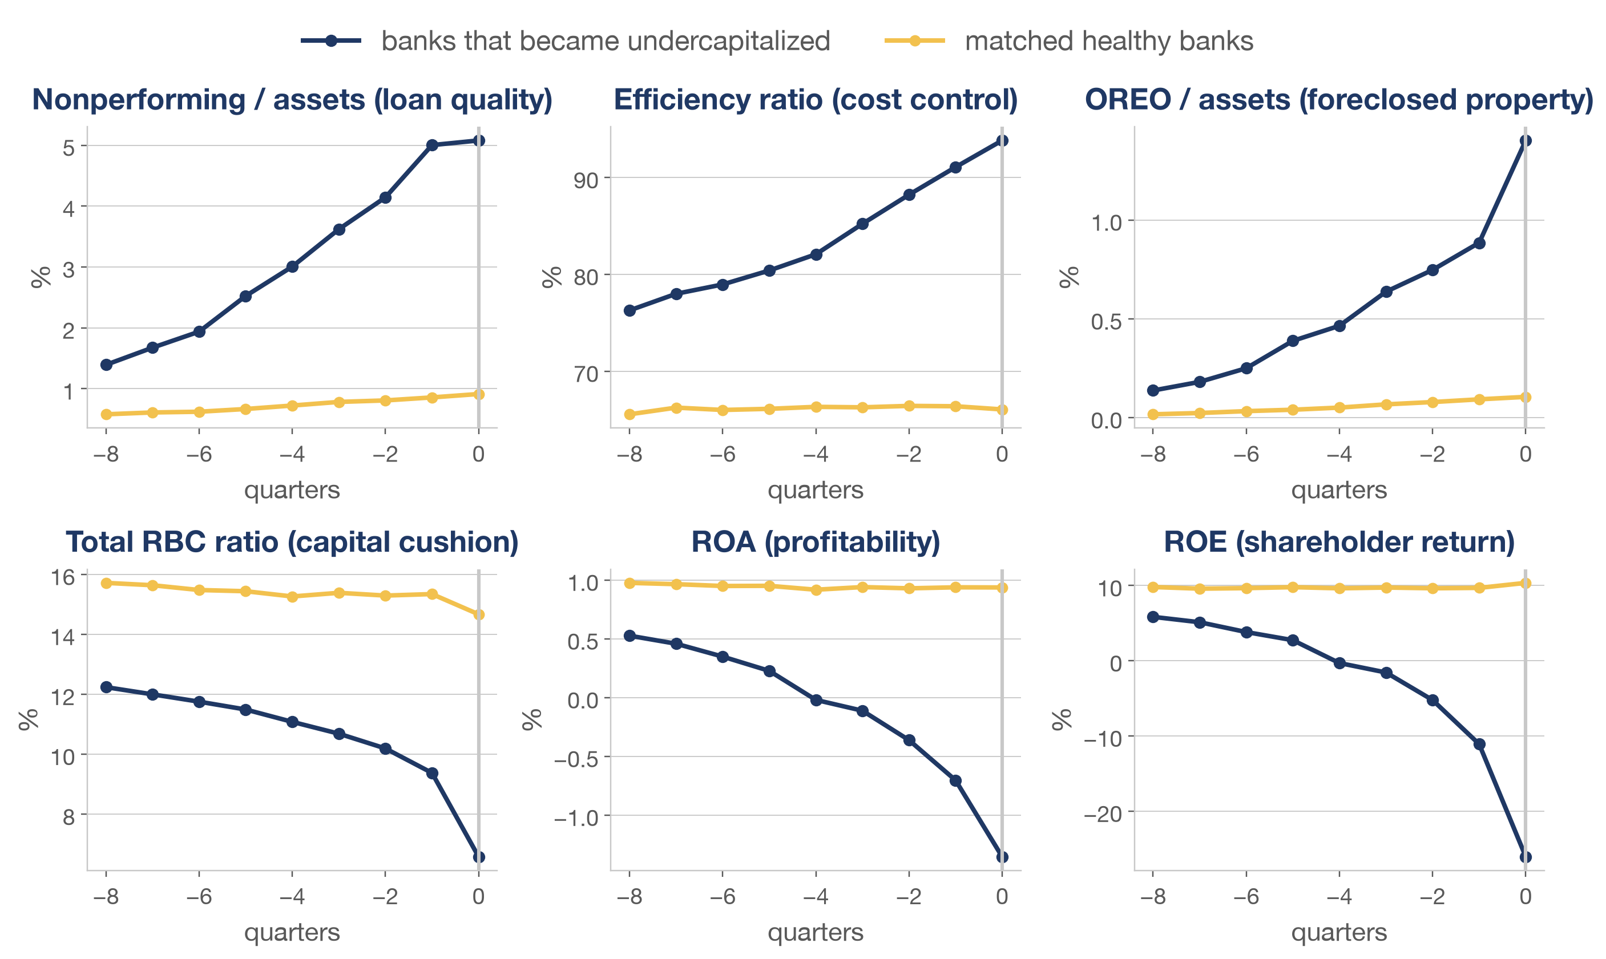
THE FINDING
Notes:
Here are my findings,
this chart shows six indicators trends for both healthy banks in yellow, and undercapitalized banks in blue.
Undercapitalized banks keep worsening across all six indicators for two years before they are finally flagged, while healthy banks stay relatively stable.
The difference shows that this effect is not due to the economy, it is bank specific.
It also shows warning signs start appearing on average up to 8 quarters early, which means we can predict the distress up to two years early.

